Slide 1
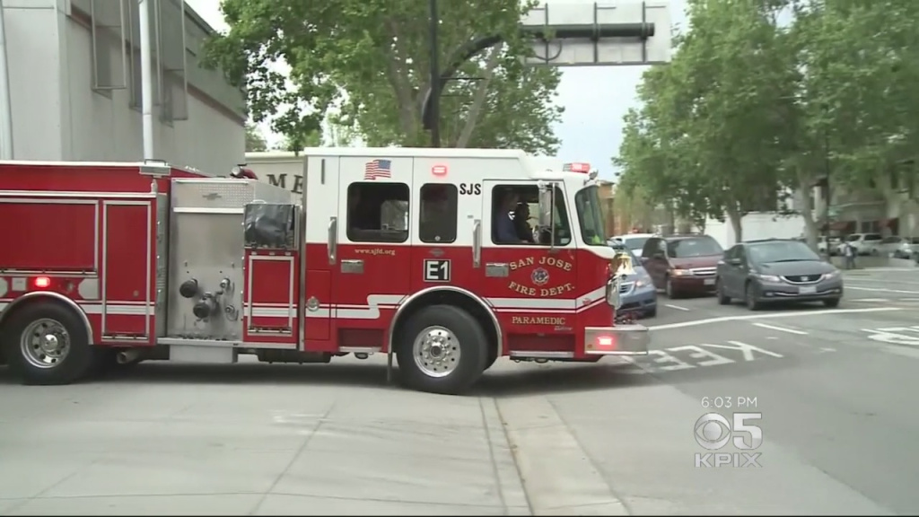
Impact Analysis of Centralized Emergency Vehicle Pre-Emption (CEVP)
Albert Gehami, ITD
In coordination with Fire and DoT
Notes:
Albert

Slide 2





Every second counts in emergency transit
0:00
1:30
4:30
1 minute travel
= 3% increase in mortality
Notes:
Albert

Slide 3
CEVP – Centralized Emergency Vehicle Pre-emption
Notes:
Albert

Slide 4

CEVP – Centralized Emergency Vehicle Pre-emption
Notes:
Albert

Slide 5

CEVP – Centralized Emergency Vehicle Pre-emption
Notes:
Albert

Slide 6
CEVP – Centralized Emergency Vehicle Pre-emption
Notes:
Albert

Slide 7
CEVP – Centralized Emergency Vehicle Pre-emption
Notes:
Albert

Slide 8
Does CEVP actually reduce Fire’s travel time?
By how much?
Notes:
Albert

Slide 9
Define Question
Define Question
Data
Data
Analysis
Results
Notes:
Albert

Slide 10
The Data
Automated Vehicle Log (AVL) – Sensor data
Computer Aided Dispatcher system (CAD) - Verified data

Slide 11
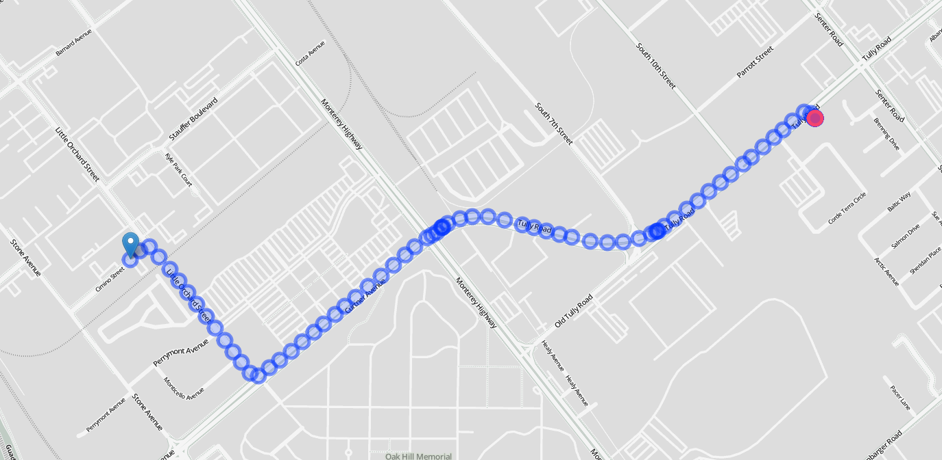
The Data
Location
Time
Road
Intersection
Total travel time
Total distance
Number of intersections
Did those intersections have CEVP?

Slide 12
The Data
Fire station 26 to Home First Shelter
Traveled 451 times
1.5 miles (2.4 km)
6 Intersections (all CEVP)

Slide 13
Before CEVP, this trip took 8 minutes
With CEVP, this trip takes 6 minutes
107 seconds faster with CEVP

Slide 14
What is the effect on all trips?
One of many trips
Regression Analysis
Notes:
Albert

Slide 16
Our Regression
How travel time is impacted by…
Number of intersections Fire passes through
Before those intersections have CEVP and after they have CEVP
Accounting for…
Total travel distance
Current demand for fire trucks
Speed limit on roads
County/other non-San Jose intersections

Slide 17
Our Regression Output
The number of seconds added to travel time per intersection
Before CEVP is implemented
After CEVP is implemented
The difference between these numbers is the impact of CEVP

Slide 18
Results
6 seconds saved per intersection

Slide 19
Takeaway
Average # CEVP intersections passed – 4
Average time saved per trip – 24 seconds
CEVP significantly reduces travel time.

Slide 20
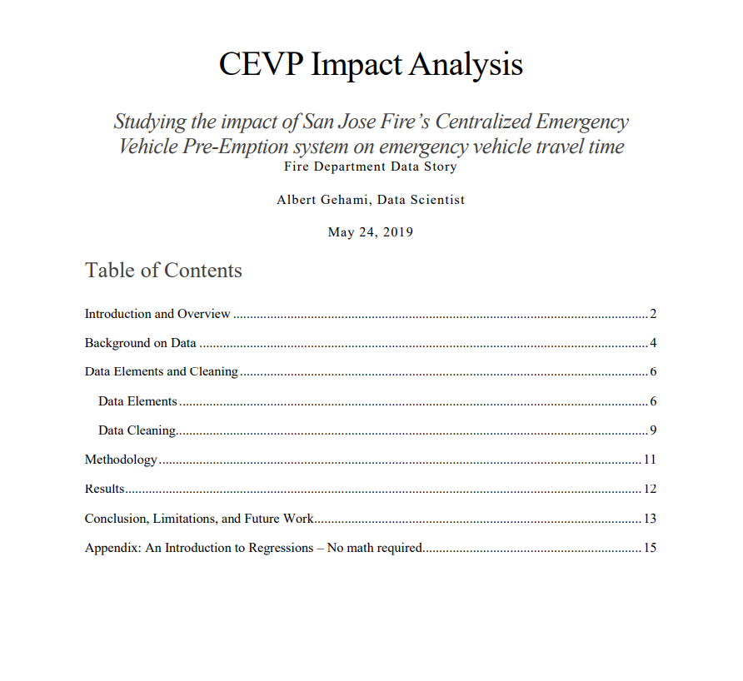
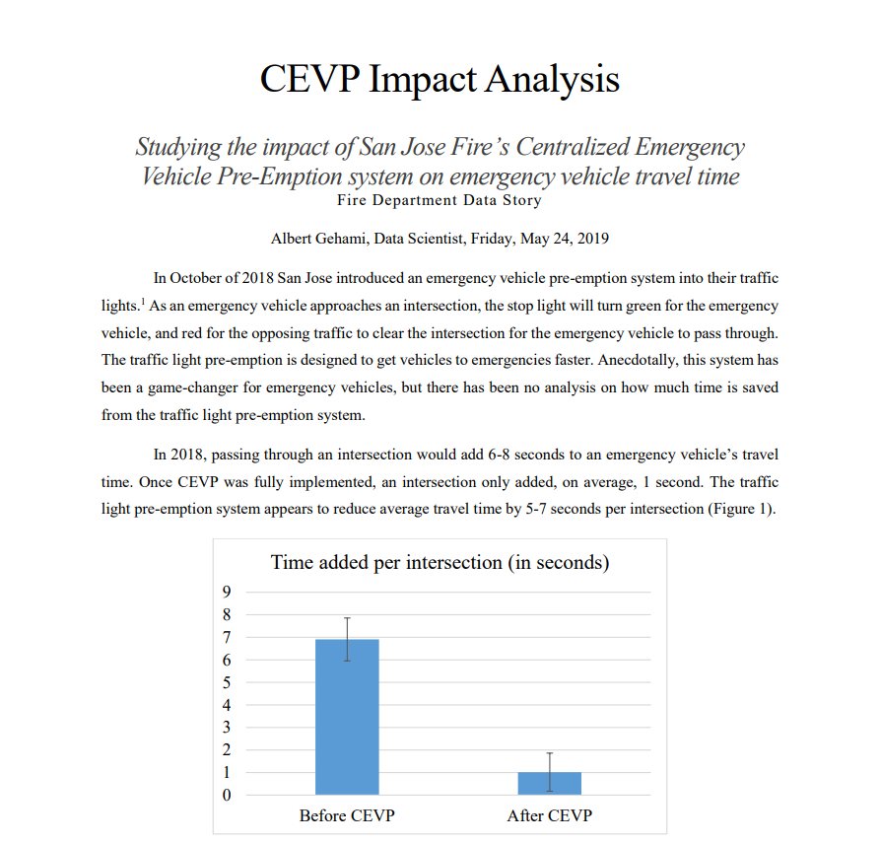
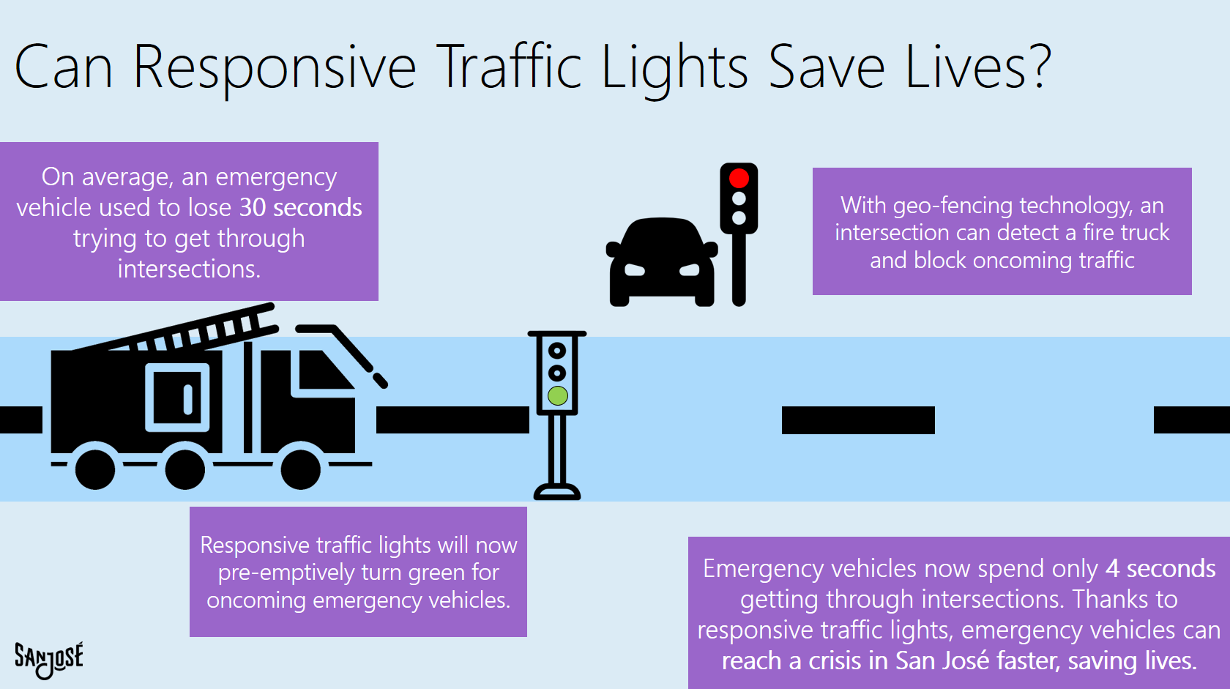
Takeaway
15 page report
2 page memo
Infographic

Slide 21
The Dream Data Project
Notes:
Albert

Slide 22
Data Science
8 months
Data Fundamentals
Data Fundamentals
2 months
What if we did better?
Notes:
Albert

Slide 23
Data Science
Data Fundamentals
3 weeks
3 weeks
We did better.
Notes:
Gave me a sample of the data while things got figured out
Machine Collected, strong data collection protocol, verification system
Approval to release and use
Genuine curiosity

Slide 24
How We Did Better
Machine-collected, human verified data
Rapid feedback
Political will
Notes:
Gave me a sample of the data while things got figured out
Machine Collected, strong data collection protocol, verification system
Approval to release and use

Slide 25
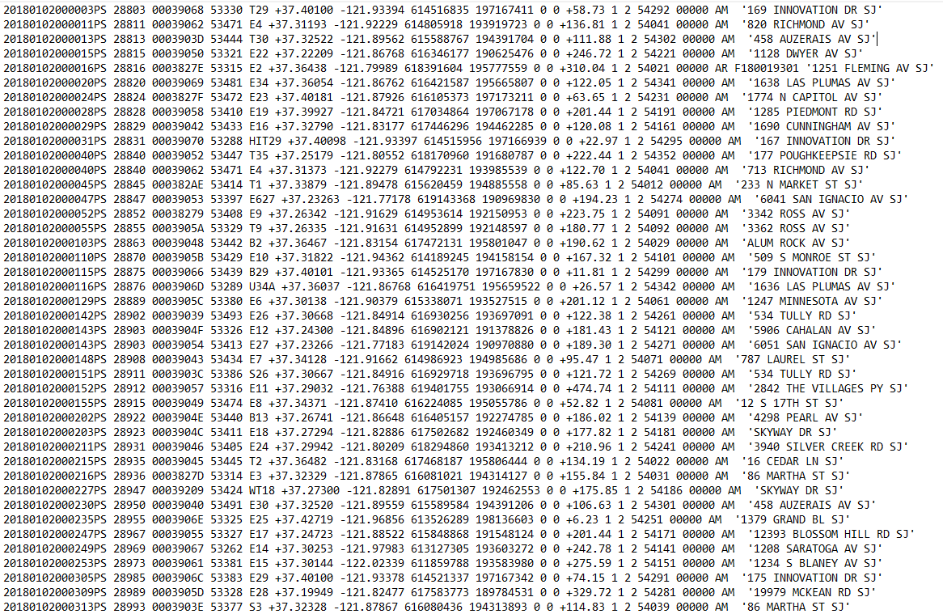
Machine-collected, human verified data
Every row is consistent
No spelling errors
Nothing accidentally left blank
Only small technical errors in arrival times
Fixed by human verification
2 month process in 2 weeks
Notes:
Gave me a sample of the data while things got figured out
Machine Collected, strong data collection protocol, verification system
Approval to release and use

Slide 26


Machine-collected, human verified data
Every row is consistent
No spelling errors
No spots accidentally left blank
Only small technical errors in arrival times
Fixed by human verification
The data is consistent with itself
Amanda
2 month process in 2 weeks
Notes:
Gave me a sample of the data while things got figured out
Machine Collected, strong data collection protocol, verification system
Approval to release and use

Slide 27
Rapid feedback
Ho Nguyen
Jose Joseph
Daily feedback
Got into the weeds
Met in person
Notes:
Gave me a sample of the data while things got figured out
Machine Collected, strong data collection protocol, verification system
Approval to release and use

Slide 28
Political will
Clear Goal
Trust in sharing data
Release as much public as possible
Notes:
Gave me a sample of the data while things got figured out
Machine Collected, strong data collection protocol, verification system
Approval to release and use

Slide 29
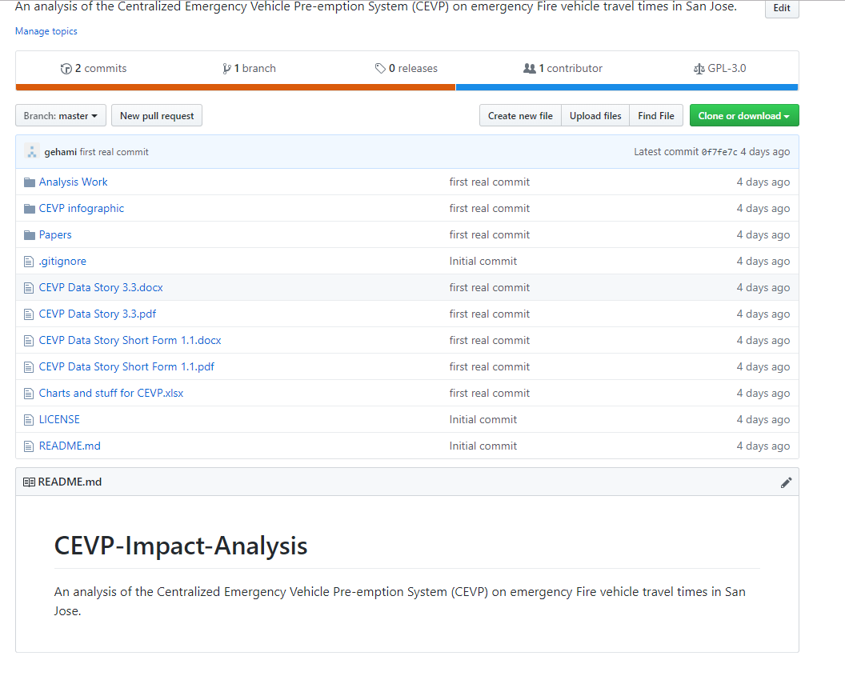
Political will
Notes:
Gave me a sample of the data while things got figured out
Machine Collected, strong data collection protocol, verification system
Approval to release and use

Slide 30
Data Driven San José
Notes:
Now we can do so much more
This is just the beginning. We know CEVP works, but now we can see where to put substations. Or analyze something with this data we didn’t even think possible
We don’t just have to rely on paying a consultant $100,000 to analyze the data. We can engage the community to work together on making a better san jose

Slide 31
Gehami@alumni.Stanford.edu
Notes:
Now we can do so much more
This is just the beginning. We know CEVP works, but now we can see where to put substations. Or analyze something with this data we didn’t even think possible
We don’t just have to rely on paying a consultant $100,000 to analyze the data. We can engage the community to work together on making a better san jose

Slide 32
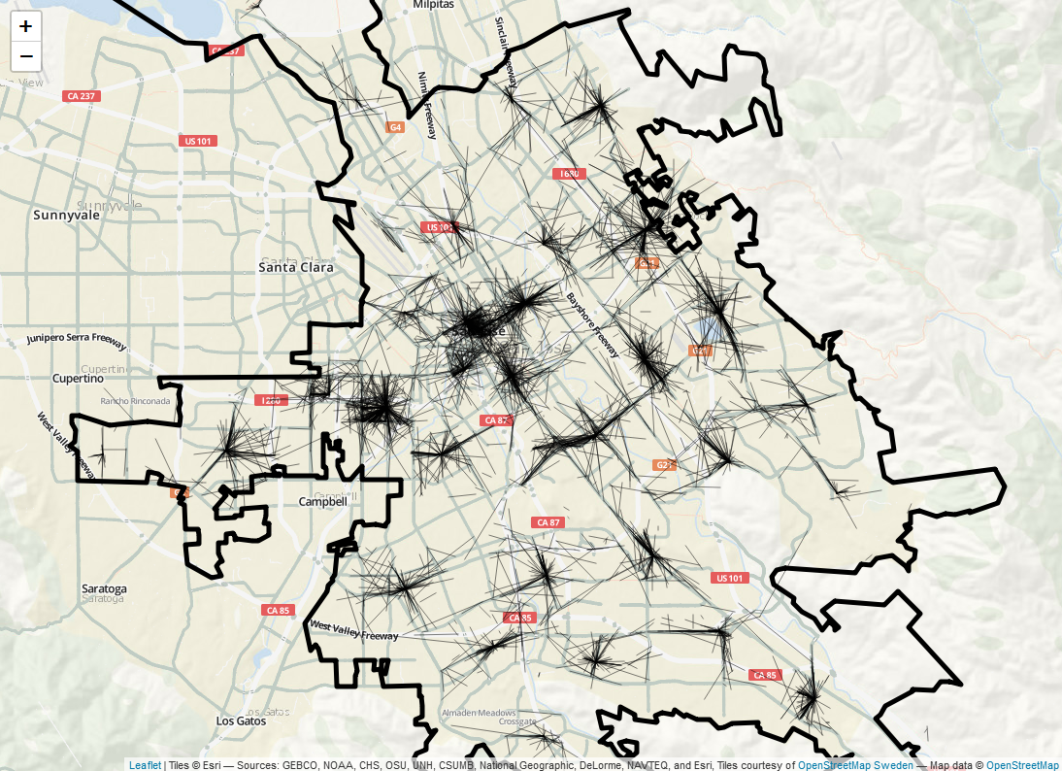
Notes:
Now we can do so much more
This is just the beginning. We know CEVP works, but now we can see where to put substations. Or analyze something with this data we didn’t even think possible
We don’t just have to rely on paying a consultant $100,000 to analyze the data. We can engage the community to work together on making a better san jose

Slide 33
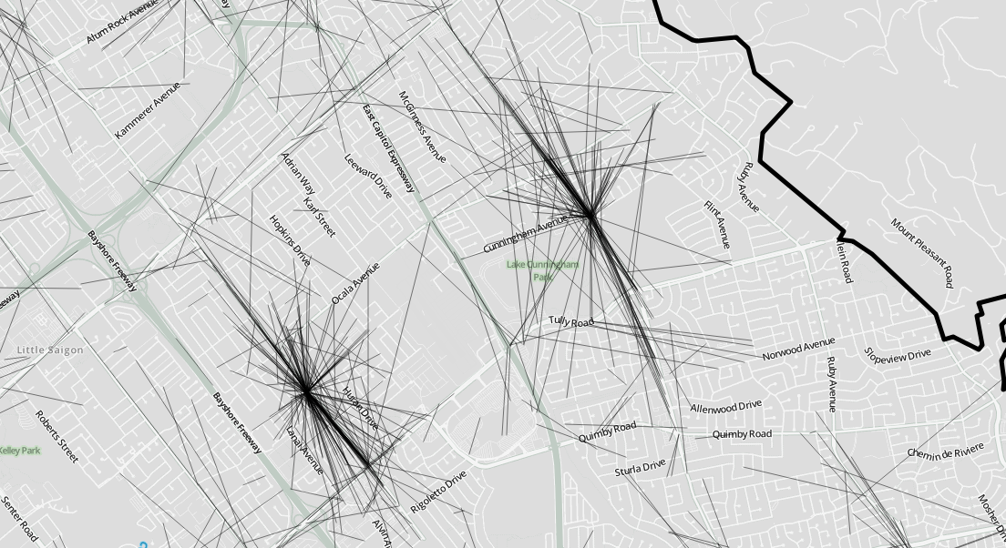
Station 21 – White & Cunningham
Station 16 – King & Cunningham
Notes:
Now we can do so much more
This is just the beginning. We know CEVP works, but now we can see where to put substations. Or analyze something with this data we didn’t even think possible
We don’t just have to rely on paying a consultant $100,000 to analyze the data. We can engage the community to work together on making a better san jose

Slide 34
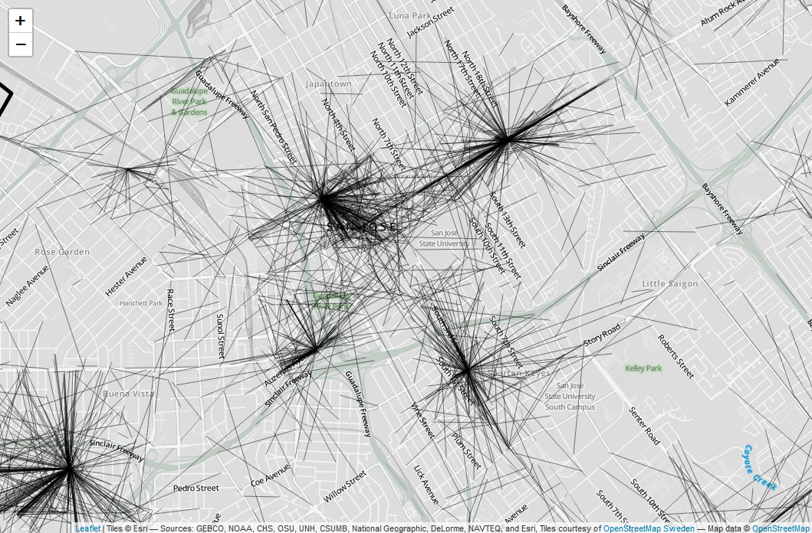
Notes:
Now we can do so much more
This is just the beginning. We know CEVP works, but now we can see where to put substations. Or analyze something with this data we didn’t even think possible
We don’t just have to rely on paying a consultant $100,000 to analyze the data. We can engage the community to work together on making a better san jose

